Slide 1


Hey Cortana, Where Am I?
Danny Warren
@dannydwarren (GitHub, Twitter, LinkedIn)
dannydwarren@gmail.com

Slide 2


Slide 3


Slide 4



Mission: Creating progress through technology that lifts the human condition.
Software Craftsmanship: TDD, Pair programming, Lean, Autonomous & Responsible Teams
Continual Improvement: This is why I can be here with you!
DANNY WARREN, SOFTWARE CRAFTSMAN
Neumont University 2009, B.S. C.S.
8 Years Custom Application Development/ Built NUI solutions:
Xamarin, UWP, WPF, Azure
Touch, Gestures, Speech, & Mouse and Keyboard
Microsoft MVP Alumnus in Windows Platform Development (Oct 2013 – 2015)
Avid Mt. Biker and aspiring Rock Climber
Notes:
Cultural Ambassador
Compliance

Slide 5

CORTANA
Cortana Skills (Speech Enabled Bots)
UWP Cortana (Speech) API

Slide 6
Cortana Skills (Speech enabled bots)
MS Bot Framework
ASP.NET WebAPI

Slide 7
Voice Commands
VCD.xml file
Used to launch Apps (Deep Link)
Used to display information provided by VoiceCommandService
Speech Recognition
Text-To-Speech (TTS)
UWP Cortana (Speech) API

Slide 8
Voice Commands
Create VCD.xml File
Register VCD File
Update Phrase Lists
Declare Dictation Phrase Topics
Declare Capabilities in Package.appxmanifest
Microphone
Internet

Slide 9
Text-To-Speech (TTS)
SpeechSynthesizer
SpeechSynthesisStream stream =
await speechSynth.SynthesizeTextToStreamAsync(textToSpeak);
-OR-
await speechSynth.SynthesizeSsmlToStreamAsync(ssml);
Sample SSML
string ssml =
@"<speak version='1.0' " +
"xmlns='http://www.w3.org/2001/10/synthesis' xml:lang='en-US'>" +
"Hello <prosody contour='(0%,+80Hz) (10%,+80%) (40%,+80Hz)'>World</prosody> " +
"<break time='500ms' />" +
"Goodbye <prosody rate='slow' contour='(0%,+20Hz) (10%,+30%) (40%,+10Hz)'>World</prosody>" +
"</speak>";
Literally stick words in the device’s mouth!

Slide 10
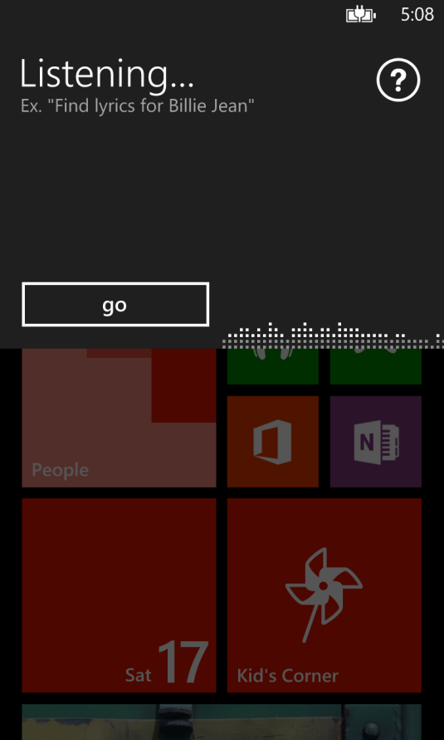
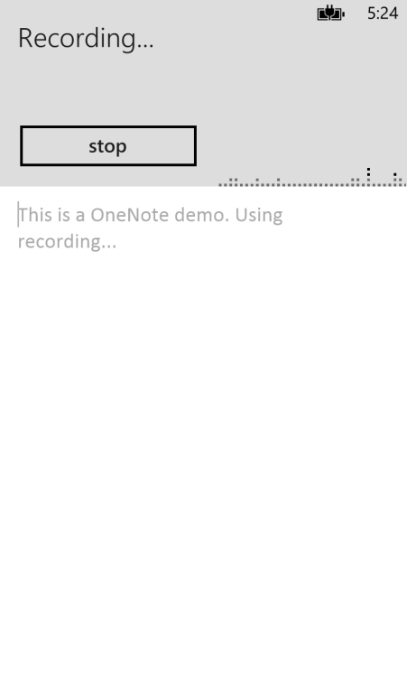
Speech Recognizers
SpeechRecognizer.RecognizeWithUIAsync()
SpeechRecognizer.RecognizeAsync()
Uses built in Speech UI
App must provide any desired UI for interaction

Slide 11
Using SpeechRecognizer
private async Task<string> StartSpeechRecognition(IEnumerable<string> commands)
{
SpeechRecognizer speechRecognizerCaptainsLogCommand = new SpeechRecognizer();
string result = string.Empty;
while (!_cancellationSource.IsCancellationRequested)
{
ISpeechRecognitionConstraint commandConstraint = new SpeechRecognitionListConstraint(commands);
speechRecognizerCaptainsLogCommand.Constraints.Add(commandConstraint);
await speechRecognizerCaptainsLogCommand.CompileConstraintsAsync();
SpeechRecognitionResult commandResult = await speechRecognizerCaptainsLogCommand.RecognizeAsync();
if (commandResult.Status != SpeechRecognitionResultStatus.Success
|| commandResult.Confidence == SpeechRecognitionConfidence.Rejected
|| _cancellationSource.IsCancellationRequested)
{
continue;
}
result = commandResult.Text;
break;
}
speechRecognizerCaptainsLogCommand.Dispose();
return result;
}

Slide 12
Choosing a ISpeechRecognitionConstraint
SpeechRecognitionTopicConstraint(
SpeechRecognitionScenario.Dictation, “TopicHint”, “Tag" )
SpeechRecognitionScenario options
Dictation
FormFilling
WebSearch
SpeechRecognitionListConstraint( new[] { "one", "two" } )
Created in code from a list of strings
Extremely light weight, fast, and accurate
SpeechRecognitionGrammarFileConstraint ( [SRGS File] )
“[Can] capture multiple semantic meanings in a single recognition”
Industry Standard (meaning portable to other platforms)

Slide 13
LOCATION

Slide 14
Single Shot Location
Geolocator.DesiredAccuracy
Uses
Check-In’s
Placing a geocache
Where am I?
Where did I park?
What country am I in?

Slide 15
Continuous Tracking
Report Interval
Movement Interval
Uses
Running
Mt. Biking
Exercising
Navigation

Slide 16
Best Practices
Use Geolocator.StatusChanged to provide progress feedback to the user
Consider Battery Life
Personally Identifiable Information
Oh, Behave!!!

Slide 17
MY RESEARCH

Slide 18
My Research: Cortana Skills
Register and manage bots here
https://dev.botframework.com/bots
Bot Builder SDK for .NET
https://docs.microsoft.com/en-us/bot-framework/dotnet/bot-builder-dotnet-overview
Samples: https://github.com/Microsoft/BotBuilder-Samples/tree/master/CSharp
\core-DirectLine : Consume bot in external application such as Mobile App or Website
\core-MultiDialogs : Dialogs calling Dialogs with retries
\demo-RollerSkill : Cortana Skill Demo
Create Cortana Skill
https://docs.microsoft.com/en-us/cortana/getstarted
Test Cortana Skill
https://docs.microsoft.com/en-us/bot-framework/debug-bots-cortana-skill-invoke

Slide 19
My Research: UWP Cortana
Cortana in Win10
http://blogs.msdn.com/b/arsurya/archive/2015/07/06/integrating-cortana-in-your-universal-windows-app-using-visual-studio-2015.aspx
VCD Definition for Win10
https://msdn.microsoft.com/en-us/library/dn954977.aspx
To activate an app and initiate an action using a voice command, the app must register a VCD file that contains a CommandSet with a language that matches the speech language that the user selected on their device. This language is set by the user on the device Settings > System > Speech > Speech Language screen.
Speech Namespace
https://msdn.microsoft.com/en-us/library/windows/apps/windows.media.speechrecognition.aspx
App Service
https://msdn.microsoft.com/en-us/library/windows/apps/mt187314.aspx
Launch Background App with Voice Commands
https://msdn.microsoft.com/en-us/library/windows/apps/xaml/dn974228.aspx

Slide 20
My Research: UWP Cortana (continued)
Guidelines for working within Cortana UI
https://msdn.microsoft.com/en-us/library/windows/apps/xaml/dn974233.aspx
Guidelines for working with foreground Speech Recognition
https://msdn.microsoft.com/en-us/library/windows/apps/xaml/dn596121.aspx

Slide 21
My Research: Location
Geolocation (namespace aka API):
https://msdn.microsoft.com/en-us/library/windows/apps/windows.devices.geolocation.aspx
Accuracy
Circumstances and Settings required to work
How to get access to Location
If denied need to send the user to settings
https://msdn.microsoft.com/en-us/library/windows/apps/xaml/dn741261.aspx
Intro to MapControl and its MVVM Support
http://jamescroft.co.uk/blog/uwp/exploring-windows-10-sdk-new-map-control/
Attached Location Prop
https://msdn.microsoft.com/en-us/library/windows.ui.xaml.controls.maps.location.aspx

Slide 22
My Research: Helpful UWP Topics
Guide to Universal Windows Platform (UWP) apps
https://msdn.microsoft.com/en-us/library/windows/apps/xaml/dn894631.aspx
Porting a Windows Runtime 8 project to a Universal Windows Platform (UWP) project
https://msdn.microsoft.com/en-us/library/windows/apps/xaml/dn705768.aspx#extension_sdks
Planning your App
https://msdn.microsoft.com/en-us/library/windows/apps/hh465427.aspx
Launch Settings
https://msdn.microsoft.com/en-us/library/windows/apps/xaml/dn741261.aspx

Slide 23


Slide 24
Download Materials
https://dannydwarren.github.io
https://github.com/dannydwarren/Cortana-Location-UWP
Interested in talking more?
Contact Me
dannydwarren@gmail.com
Mention That Conference
@dannydwarren (GitHub, Twitter, LinkedIn)

